Slide 1
General principles of history taking

Slide 2
Medicine is learned by the bedside and not in the classroom sir William Osler
The consultation sequence
History
Examination
Explanation to patient of findings
Possible diagnoses. Differential diagnoses
Management plan (further tests and treatment)
Ordering off, explanation off, appropriate tests
Treatment indications and managing, control examination and tests
Recording of history

Slide 3
History taking
What in the beginning?
The treatment of a patient begins at moment one reaches bedside or the patient enters the consulting room
Manner
Dress
Hand washing
Introducing yourself

Slide 4

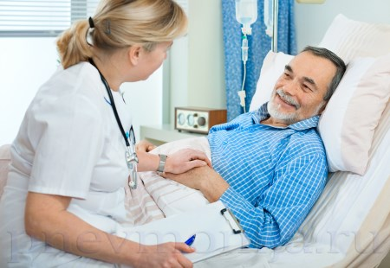

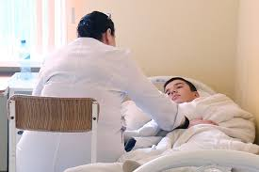

Slide 5
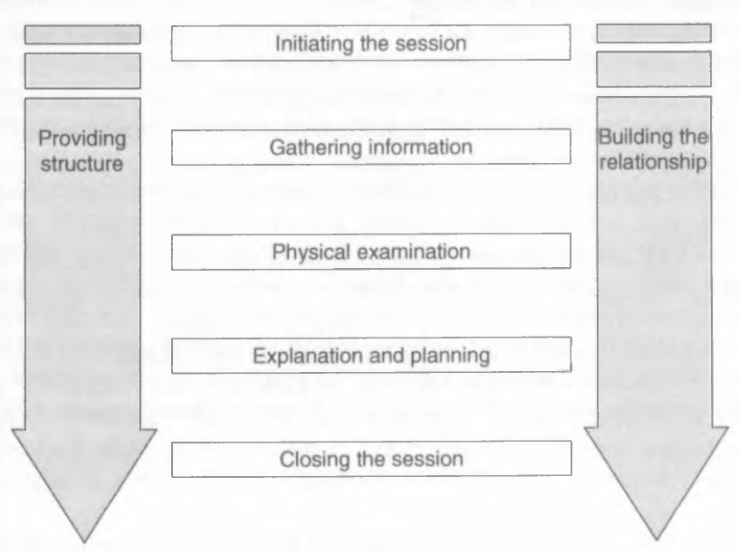

Slide 6
Initiating of session
Preparation
Establishing initial rapport:
        Greets patient and obtains patient’s name
        Introduce yourself
        Demonstrate respect and interest, attends to patient physical comfort
Identify the reasons for consultation

Slide 7
reasons for consultation
• They have reached their limits of tolerance
• They have reached their limits of anxiety
• They have problems of daily living presenting as symptoms
• For prevention
• For administrative reasons

Slide 8
Plan
1. General information
2. Chief complaint(s)
3. Present illness – anamnesis morbi
4. Past history – anamnesis vitae
5. Family history
6. Personal and social history
7. Review of systems

Slide 9
General information – introducing question
Source of the history
—usually the patient, but can be
a family member or friend, letter of referral, or the clinical record
If appropriate, establish the source of referral, because a
written report may be needed
Reliability
Varies according to the patient’s memory, trust, and mood
Name
Age
Gender
Education
Occupation
Matrial status
Verbal
Non-verbal

Slide 10
Non verbal
Facial expression
Tone of voice
Body position
Behavior
Why non verbal signs important?

Slide 11
Presenting principal symptoms
Identify a major complaint
Clarify details
Where is the problem?
What is the nature of the symptom?
How does it affect the patient?
Why did the patient develop it?
The first part of the interview patient should lead the discussion
But in the second part the doctor should take more control and ask specific questions

Slide 12
Presenting principal symptoms
Subjective Data
Objective Data
What the patient tells you
The symptoms and history, from
Chief Complaint through
Review of Systems
Patient tell his history in their own words
Is it important what words are used?
What you detect during the examination,
laboratory information, and test data
All physical examination findings, or signs

Slide 13
Possible questions
Good
Unwanted
What worries you?
How did you get sick?
Why did you go to the doctor?
Tell me where your pain is concentrated?
When did you get sick?
Why did you apply only now?
Are you taking the medicine
Do you have constricting chest pain?

Slide 14
What a difference?
Illness
diseases
Patient’s unique experience of sickness
Disease – biomedical cause of sickness in terms of pathophysiology
the patient is not a source of objective information
He may forget something, or remember inaccurately, or offer his version of the cause of the disease
He can pretend, exaggerate or downplay - intentionally or sincerely

Slide 15
Skilled Interviewing Techniques
● Active listening ● Reassurance
● Empathic responses ● Partnering
● Guided questioning ● Summarization
● Nonverbal communication ● Transitions
● Validation ● Empowering the patient

Slide 16
Complaints
main
active
secondary
identified

Slide 17
Main complaint
S ite
O nset
C haracter
R adiation
A lleviating factors
T iming
E xacerbating factors
S everity
The events should be placed in chronological order
Identify and create a full medical picture of the individual

Slide 18
Anamnesis morbi
disease onset
order of appearance and change of manifestations
frequency and seasonality
results of previous treatment, especially self-medication
reasons for this appeal
acute illness - hourly or even minute-by-minute development of events matters
chronic - days, weeks, months

Slide 19
Drugs and treatment history
Medications should be noted, including name, dose, route, and frequency of use
Their action
Effects on the patient
Allergies, including specific reactions to each medication, such as rash or nausea, must be recorded, as well as allergies to foods, insects, or environmental factors.

Slide 20
Allergic anamnesis
How to ask?
the patient may take for allergy manifestations that are actually something else
Allergic reactions to drugs should be recorded in the medical history and HIGHLIGHTED!!!
Need to clarify:
what kind of manifestations?
when?
what exactly, in what situation?
if you are allergic to the drug - which drug, in what circumstances

Slide 21
Anamnesis vitae
Childhood Illnesses: These include measles, rubella, mumps, whooping
cough, chickenpox, rheumatic fever, scarlet fever, and polio. Also included
are any chronic childhood illnesses.
For children – birth history
Adult Illnesses: Provide information relative to Adult Illnesses in each of the
four areas:
Medical, Surgical, Obstetric/Gynecologic (for female), Psychiatric
Health Maintenance

Slide 22
Anamnesis vitae
Smoking – smoking index
Alhogol – Why many drinks a week
Allergy anamnesis
Family History
Personal and Social History: Lifestyle, epidemiological anamnesis, travel history, occupation, life conditions, sexual history

Slide 23
Alhogol anamnesis
CAGE Questionnaire “CAGE” is an acronym formed from the italicized words in the questionnaire (
      cut
      annoyed
      Guilty eye
The CAGE is a simple screening questionnaire to id potential problems with alcohol.
Two “yes” responses is considered positive for males;
one “yes” is considered positive for females.
Please note: This test will only be scored correctly if you answer each one of the questions.

Slide 24
Please check the one response to each item that best describes how you have felt and behaved over your whole life:
Have you ever felt you should cut down on your drinking?
__Yes __No
Have people annoyed you by criticizing your drinking?
__Yes __No
Have you ever felt bad or guilty about your drinking?
__Yes __No
Have you ever had a drink first thing in the morning to steady your nerves or get rid of a hangover (eye-opener)?
__Yes __No

Slide 25
Task
Pair up
One of you is the patient, the second doctor
The patient went to the doctor with a problem
(remember the real health problem from your life, for example, SARS)
The doctor should have a medical history by plan

Slide 26
what symptoms do you consider to be leading?

Slide 27
Syndrome
A logical combination of symptoms,
combined by a single pathogenesis,
characterizing a certain pathological condition

Slide 28
What syndromes can they be collected into?
Catarrhal
Fever
Intoxication

Slide 29
Part of anamnesis vitea | Detailes | Question to patient

